Slide 1
Clerks’ Information Update Autumn Term 2018 5 September 2018 Presented by Tina Weavers

Slide 2
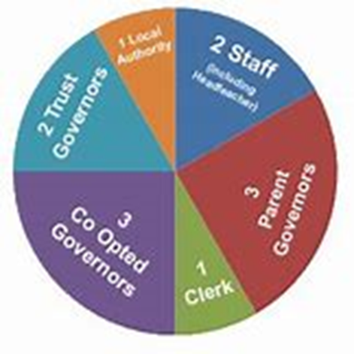
The DfE recognises that professional-quality clerking is critical to the effectiveness of a governing board

Slide 3
Clerks’ Information Update
Summer Term 2018
Autumn Term Agenda
Discussion
Information Update
Discussion
Ofsted Update
Open Forum
April 2018
Presented by
Tina Weavers

Slide 4
Clerks’ Information Update
Summer Term 2018
DRAFT
AUTUMN
TERM
AGENDA
Presented by
Tina Weavers

Slide 5
QUICK QUESTION
When should Governors be ‘named’ in minutes?
Who should never be ‘named’ in minutes?
5 minutes to think about this on your tables

Slide 6
When Governor names should be mentioned in minutes
In Apologies for Absence
In Declarations of Interest – eg declaring new interests
Introducing new governors
Governor visits
When assigning roles – but name the title eg Lead Finance Governor once assigned
When assigning or delegating actions
When names should never be mentioned in minutes
Pupils
Individual staff – always try to use role names
GOVERNORS ASKING AND RESPONDING TO QUESTIONS

Slide 7
INFORMATION UPDATE
Good estate management for schools – updated 24.7.18
Statutory guidance on Health, and Relationships and Sex Education will not become compulsory until September 2020 – it had originally been intended to become statutory from 2019
DfE A Guide to apprenticeships for the School Workforce – updated June 2018
Revised guidance on what maintained, academies and free schools should publish online (in Pack)
DfE scraps disqualification by association for schools
New statutory careers requirements for secondary schools
New ruling on exclusions
Introduction of full National Funding Formula delayed

Slide 8
INFORMATION UPDATE
Governors are being encouraged to improve their data literacy – link on Update sheet on DfE document for Governors
Land & Buildings Collection Tool
2018 Teachers’ Pay Award
Governance documents from ICSA www.icsa.org.uk
Secretary of State announced funding for governor and trustee training to be doubled to £6m up to 2021 – it is hoped by the NGA that this will include clerks
DfE Data Protection Toolkit – updated August 2018
Primary School Accountability – how progress scores are calculated and floor standards
DfE School Workforce Planning – some good questions for Governors/Trustees to ask Heads when reviewing staffing structures

Slide 9
INFORMATION UPDATE
SEND Governance Review Guide – vital for any governor with responsibility for SEND
Sexual violence and sexual harassment between children in schools and colleges – this advice and guidance covers all ages of children under the age of 18
Approaches to preventing and tackling bullying – update from last year’s guidance and case studies

Slide 10
OFSTED UPDATE
Ofsted has a new inspection report website – much more informative, easier to use and simpler to access on non-desktops
Ofsted is revising its current practice for the inspection of MATs and hopes to improve the inspection experience for MAT leaders and their academies through a new approach it is trialling – it will be launching a new training programme for inspectors so that they better understand the responsibilities a trust has for leadership and management of its schools
Schools are failing to inform governors or trustees about imminent Ofsted inspections
Ofsted has recently published its School Inspection Handbook
Ofsted published its latest School Inspection Update in July 2018

Slide 11
What questions should Governing Boards be asking about GDPR?
5 minutes to discuss

Slide 12
What questions should Governing Boards be asking about GDPR?
Do we know why it is important and what it means to us as a school?
Have all the staff been provided with the relevant awareness training on data protection and have all staff practices been reviewed to ensure compliance?
Do our staff know who the Data Protection Officer is and how and when to contact the DPO?
Have we appointed the right person as our Data Protection Officer and are they confident and able to fulfil the role?
Have all our policies and data processing procedures been updated to take account of GDPR? Do our staff know where to access them?
Have we reviewed what personal data is held, where it is stored and why it is being held?

Slide 13
What questions should Governing Boards be asking about GDPR?
Do we have a robust and tested procedure in place in the event of a security incident or a data breach? Do the staff know and understand how to report a data breach?
Are we confident that we can demonstrate compliance with GDPR? Where are the relevant documents, such as the retention policy, codes of conduct?
Have all existing contracts and agreements with third parties been reviewed to ensure that they too are compliant?
How will the Governing Board ensure that data protection is monitored going forward and that we will continue to remain fully compliant? Do we need to appoint a Data Protection Link Governor?

Slide 14
NGA’s Outstanding Governance Awards 2019 are now open to enter
www.nga.org.uk/Be-a-Governor/Celebrating-Governance.aspx

Slide 15
