Slide 1
Clerking a trust board Keeping it strategic
Clare Collins
NGA Head of Consultancy

Slide 2
Clerking a trust board
At the end of this workshop, you should have a clear understanding of the challenges facing clerks when servicing a trust board. We will do this though discussions on:
What being strategic means
Balancing strategy and compliance
The role of the clerk
Issues and possible solutions

Slide 3
1. Being strategic

Slide 4
Discussion
Governors and trustees are always being told to ‘be strategic’ …
… what does ‘being strategic’ mean to you?
Notes:
Purpose of slide: to introduce discussion to start participants engaging with the session
Take feedback
Gauge the group’s understanding of the concept of being strategic

Slide 5
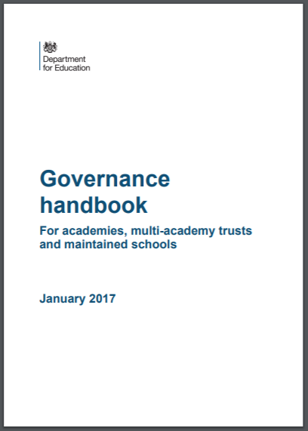
Vision and strategy
“Governing boards have a significant degree of autonomy in our increasingly school-led system. They are the vision setters and strategic decision makers for their schools. They play a vital role in ensuring the best possible education that takes every child as far as their talents allow.”
Notes:
Purpose : to remind delegates about the role of the governing board in relation to being strategic

Slide 6
The trust’s vision and strategy
Vision – what the trust will look like in 3-5 years
Key priorities agreed
Measures / targets set
Milestones / monitoring schedule
Regular reporting / review
Budget and staffing in place

Slide 7
The strategy document
S.W.O.T.
Where are we now?
Our vision
Where do we want to go?
Our priorities for improvement
How are we going to get there?
SMART targets for each priority
How will we know when we have arrived?
Termly milestones
Are we nearly there yet?
Monitoring arrangements
Are we happy with the progress we are making?

Slide 8
2. Balancing strategy with compliance

Slide 9
DfE guidance, primary documents
Your articles of association
Your scheme of delegation
Your funding agreement

Slide 10
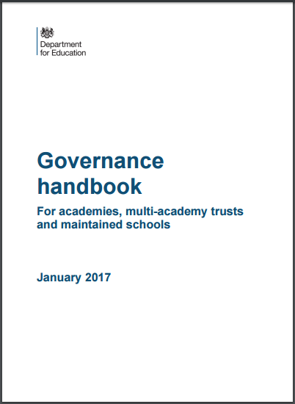
Safeguarding guidance

Slide 11
Clerking exclusion panels

Slide 12
Clerking employment panels
Your trust’s
HR policies

Slide 13
3. The role of the clerk

Slide 14
Discussion
What ideas do you have for keeping your board operating strategically?

Slide 15
Scenario
In meetings, the senior executive leader talks a lot and has a tendency to be defensive
The chair manages this well, being as positive as possible but other trustees are becoming more and more passive
The chair asks for data on how, across the trust, pupils with SEN are progressing against national averages
The senior executive leader responds with a list of ‘reasons’ why this data cannot be provided
The chair accepts that it may not be easy, that there is a lot to do, but asks when it will be possible to provide the data
The senior executive leader says that it is difficult to say
It feels like an impasse
As clerk, is there anything you should or could do?

Slide 16
Practical approaches
Board structures
Size of board
Board practices
Annual planner / schedule of meetings
Chair undertakes a 360° appraisal
Board packs
Circulated well in advance
Quality committee reports (especially where compliance is delegated)
Number of committees
Working parties / task and finish groups
Role descriptions
Code of conduct
Induction and training
Chair / vice appraise trustees’ contribution
Clerk does ALL the admin
Succinct reporting on strategy and compliance with supporting evidence of progress properly triangulated
Chair, senior executive leader and clerk plan agendas
Trustee visits aligned with the trust’s values and strategic aims
Trustee visits’ reported

Slide 17
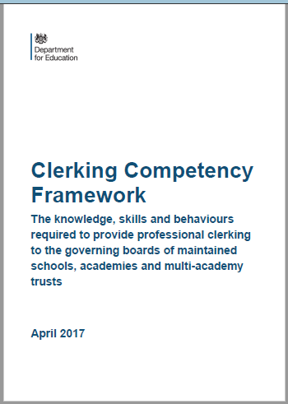
The DfE’s Clerking Competency Framework
Demonstrates the importance of professional clerking and depth and breadth of knowledge skills and behaviours required to support it

Slide 19
clare.collins@nga.org.uk

